Slide 1
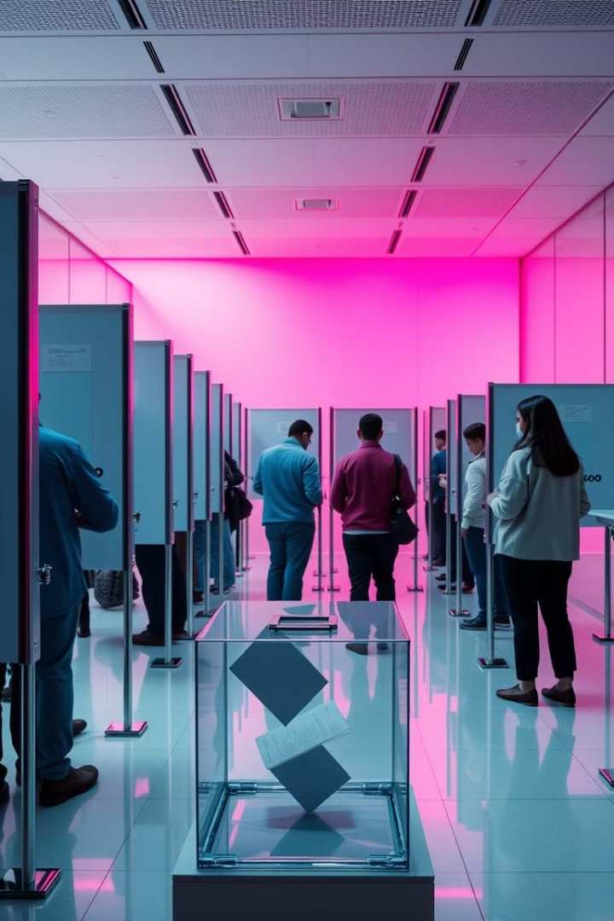
Introduction to Voting system using C++
Designing an efficient and user-friendly voting system is crucial for facilitating a seamless democratic process. This presentation will provide an overview of a C++-based voting system, highlighting its key objectives, features, and a step-by-step guide on how to utilize its functionality.

Slide 2


Objectives of the Voting system
1
Accessibility
2
Security
Enabling voters to easily access and participate in the electoral process from any device, anywhere.
Ensuring the integrity of the voting system through robust security measures and data encryption.
3
Transparency
Providing voters with clear and comprehensive information about the voting process and election results.

Slide 3
Key Features and Functionality
Voter Registration
Ballot Selection
Results Tracking
Secure and intuitive process for voters to register and update their information.
Streamlined interface for voters to review candidates, make their selections, and submit their ballots.
Real-time display of election results, providing transparency and up-to-date information to voters.

Slide 4
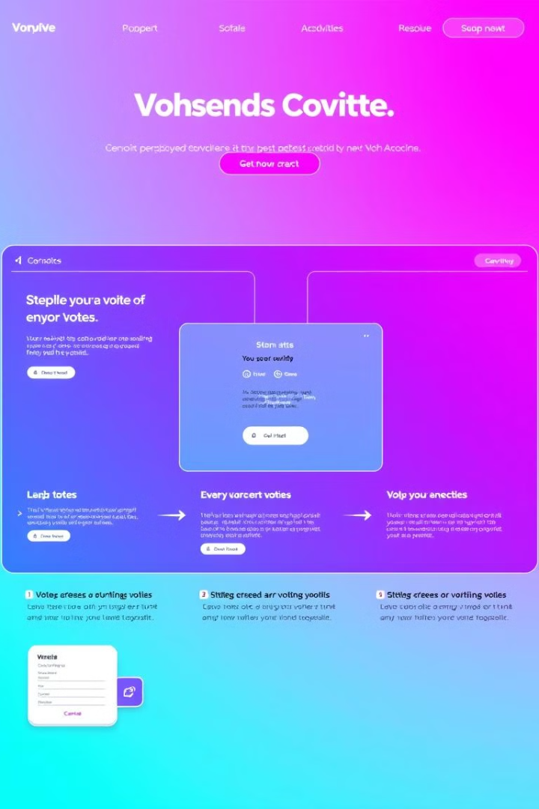
Step-by-Step Guide on How to Use the Voting system
1
Register
Visit it and complete the voter registration process, providing the necessary personal and residency information.
2
Review Candidates
Explore the candidate profiles, their platforms, and make informed decisions about your selections.
3
Cast Your Ballot
Navigate to the voting section, review your choices, and securely submit your ballot.

Slide 5

Summary and Conclusion
Empowering Voters
Secure and Transparent
The voting website empowers citizens to actively participate in the democratic process, making their voices heard.
Advanced security measures and real-time result tracking ensure the integrity and transparency of the voting system.
Continuous Improvement
The website will be regularly updated and enhanced to adapt to the evolving needs of voters and election administrators.

Slide 6
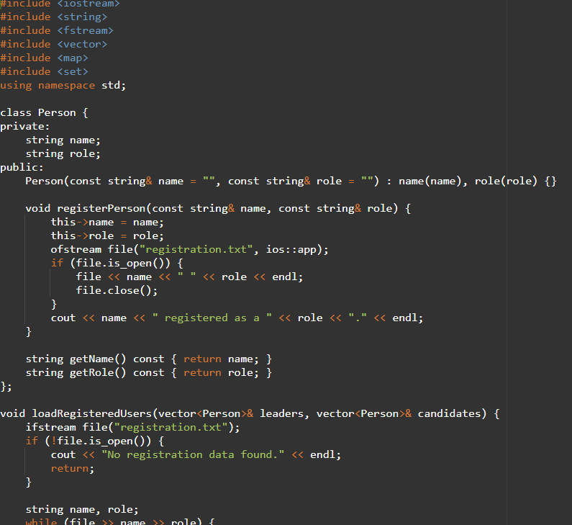
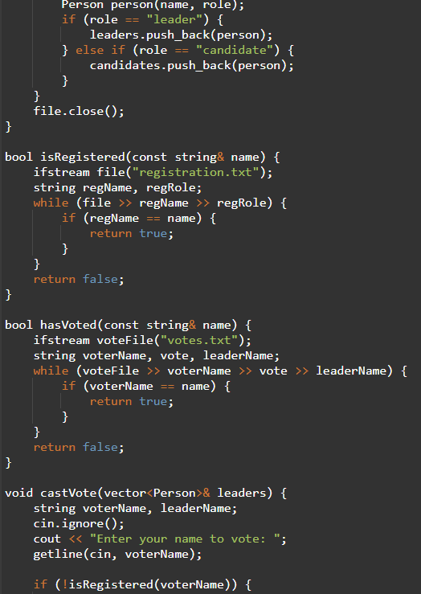
CODE:

Slide 7
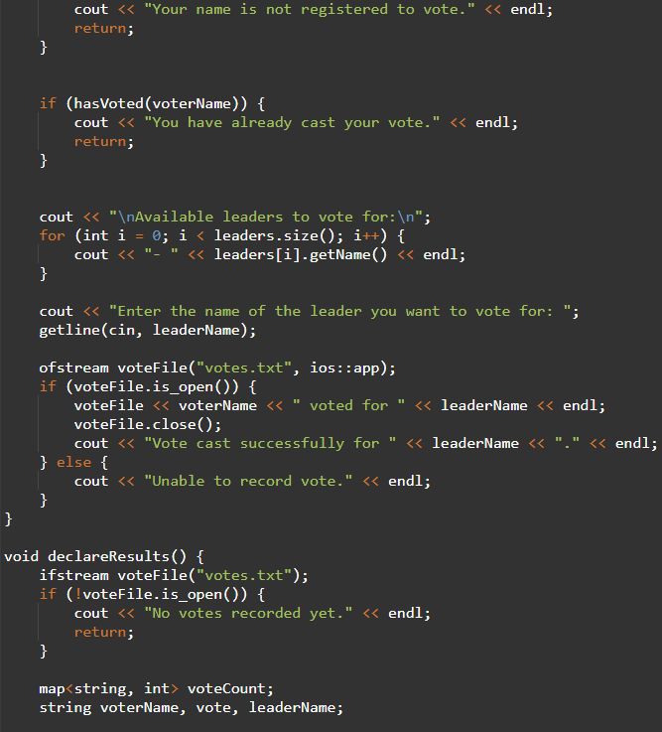
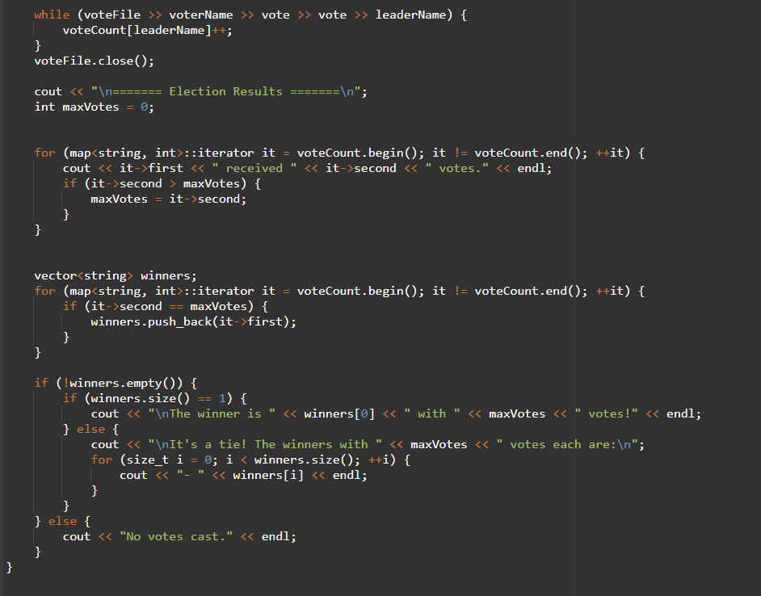
CODE:

Slide 8
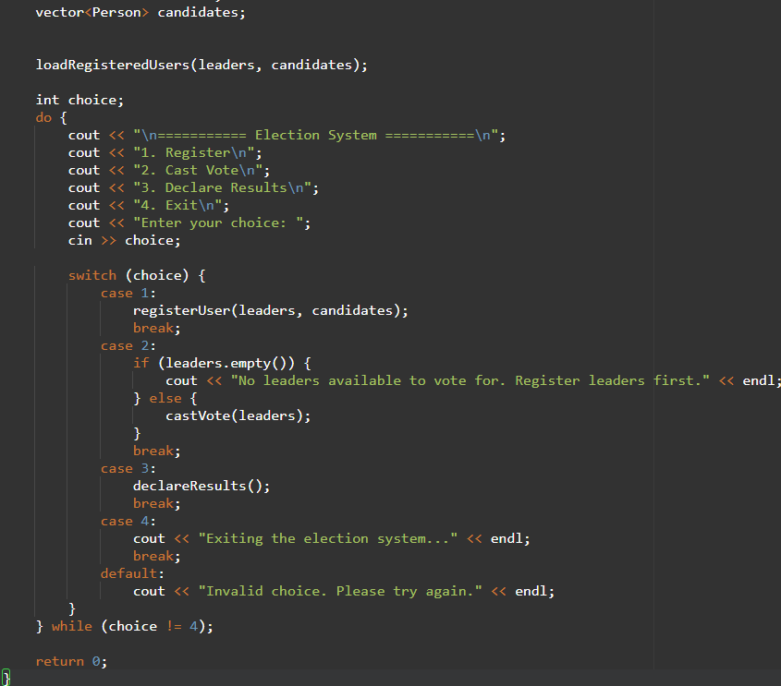
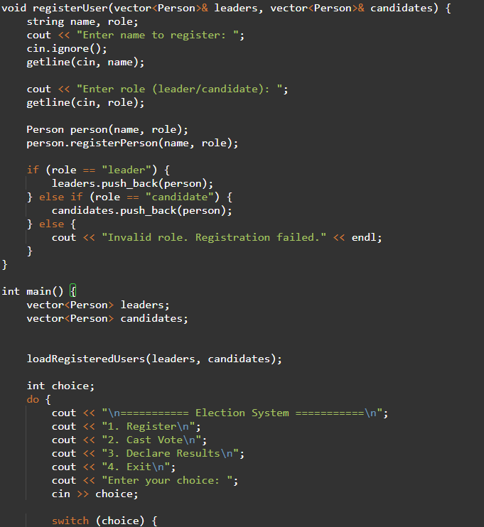
CODE:

Slide 9

Thank You
AP23110010265 (G. SEENU TEJA) AP23110010321 (G. POORNA)
AP23110010314 (B. SIDDARTHA) AP23110010303 (M.LEELA VARDHAN)

